Slide 1
E-Commerce Sales
Presented by-Hritik Kumar

Slide 2
Problem Statement & Objective
Understand overall business performance
Clean and prepare raw data
Identify KPIs and trends
Analyze customers, products, and sales
Provide actionable business insights

Slide 3
Dataset Overview
Customer table: 3 attributes
Order table: 11 attributes
Orders, Product
Time intelligence enabled
Total unique products: 45

Slide 4
Data Cleaning & Preparation
Removed blanks and unused columns
Replaced null values
Cleaned and standardized text
Corrected data types
Power Query (M language)

Slide 5
Data Modeling
Star schema design
One-to-Many: Customers → Orders
Single-direction filtering
Date table enabled

Slide 6
Key KPIs & DAX Measures
Total Revenue (SUMX)
Total sales
Total customer
Average Rating
YoY sales change
Previous year sales etc.

Slide 7
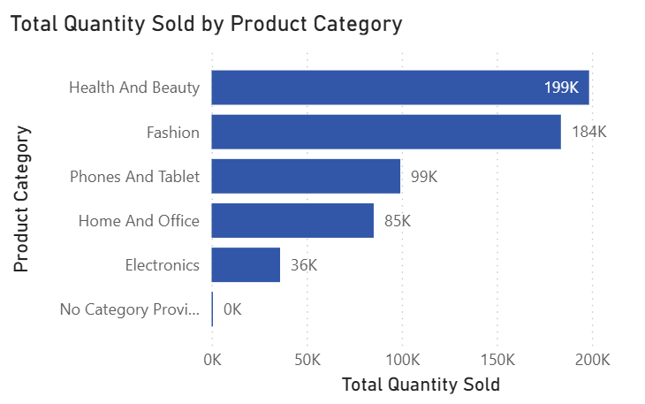
Product Popularity Analysis
Health and Beauty, Fashion, Phones & Tablets lead lowest is Electronics with 36k
High demand products identified
Low sellers need optimization

Slide 8
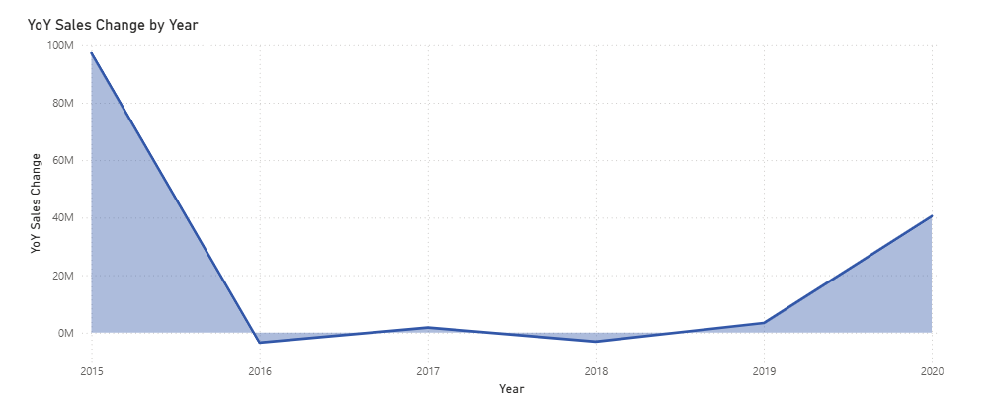
Year-over-Year Product Sales
Strong recovery in 2020
₹4.05 Cr YoY increase
Electronics drive growth

Slide 9
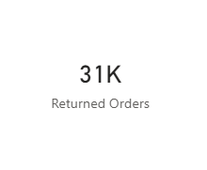
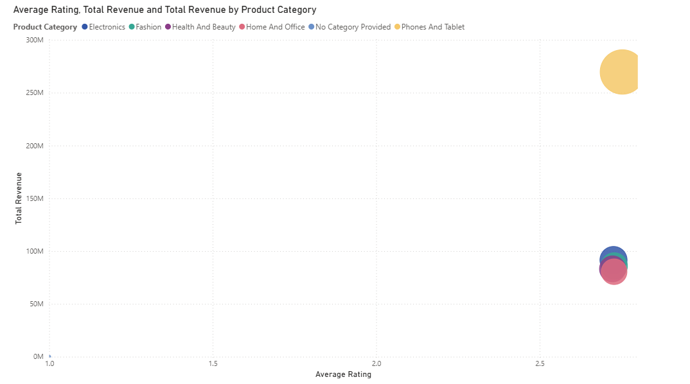
Returns & Ratings Impact
Returns linked to low ratings
Ratings influence revenue
Returns signal quality or description gaps

Slide 10
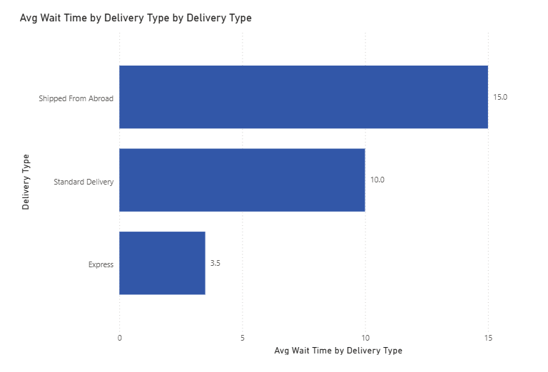
Delivery & Wait Time Analysis
Avg wait time ~9.5 days
Shipped from Abroad slowest
Express fastest

Slide 11
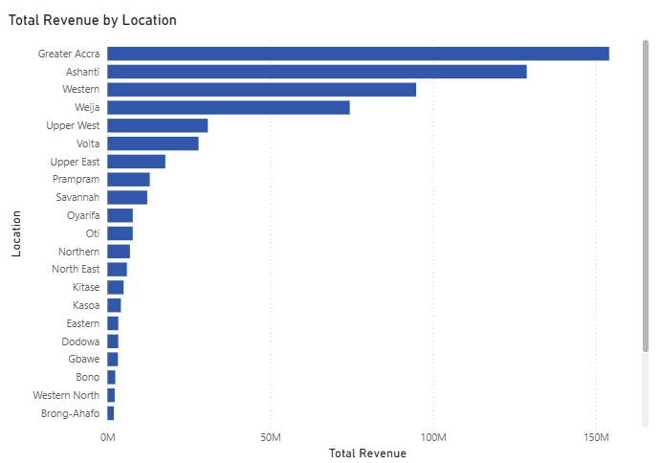
Geographic & Seasonal Insights
Top regions: Greater Accra, Ashanti, Western
Low-performing months: September, June, November
Regional demand differences guide marketing & logistics

Slide 12
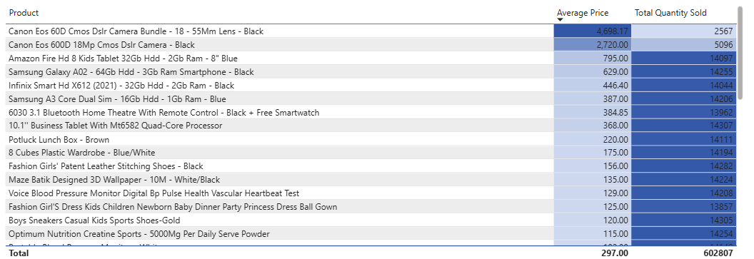
Pricing & Marketing Strategy
DSLR cameras & premium devices underperform
High price limits demand
Targeted discounts & bundles recommended
EMI & loyalty incentives suggested

Slide 13
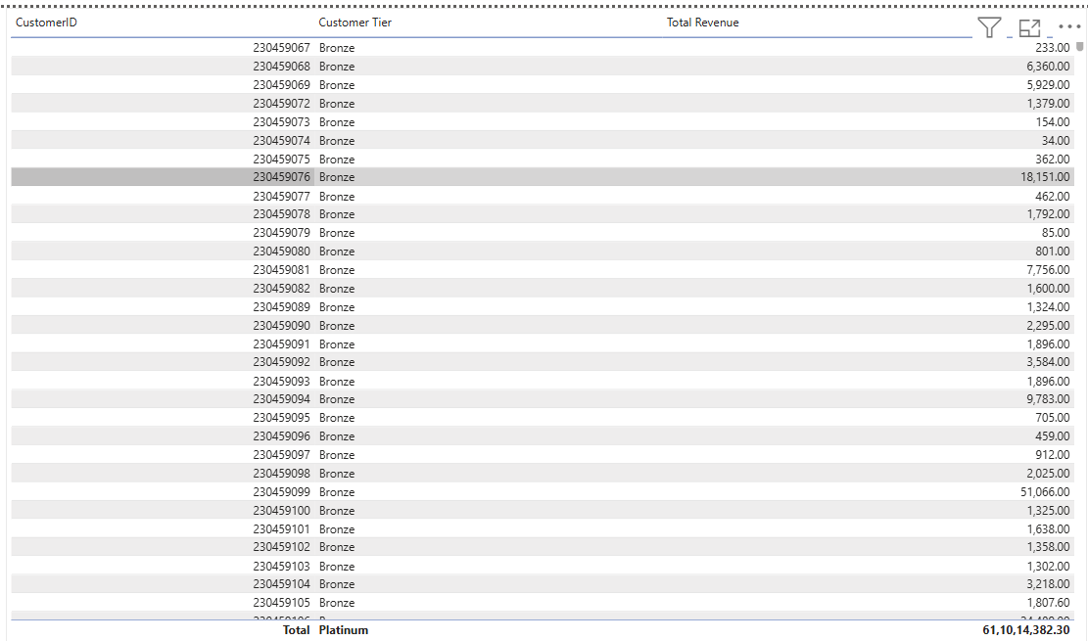
Customer Loyalty Program
Tier-based segmentation
Rewards boost retention
Goal: retention, frequency, lifetime value

Slide 14
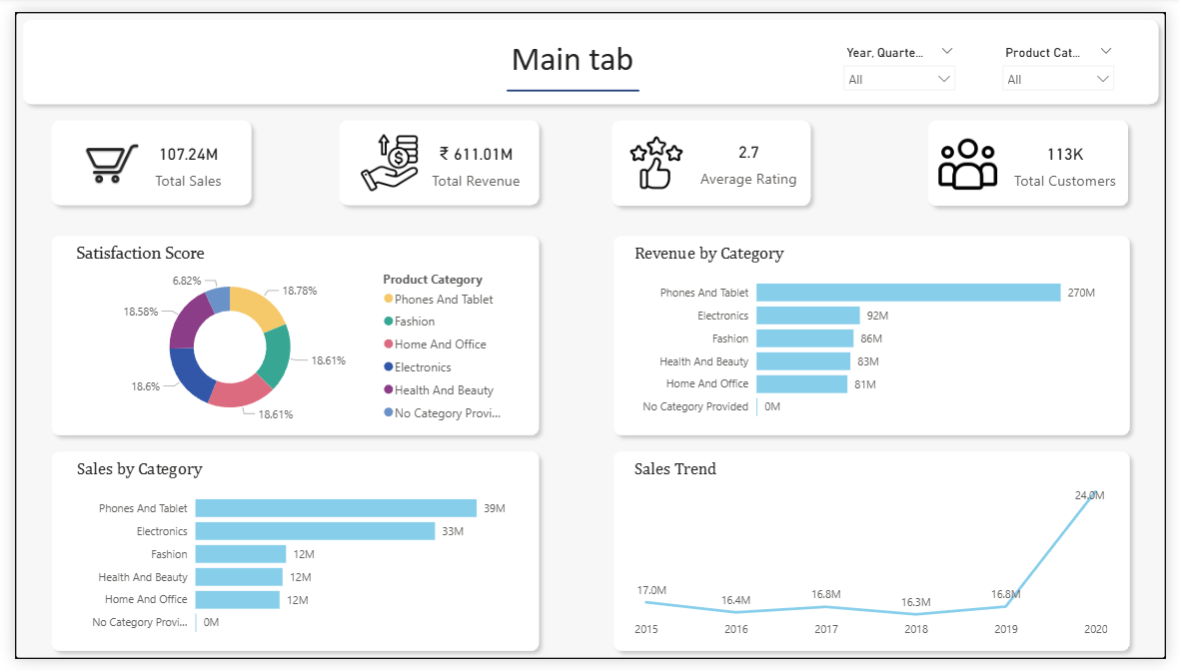
Power BI Dashboard Structure
• Main Tab overview

Slide 15
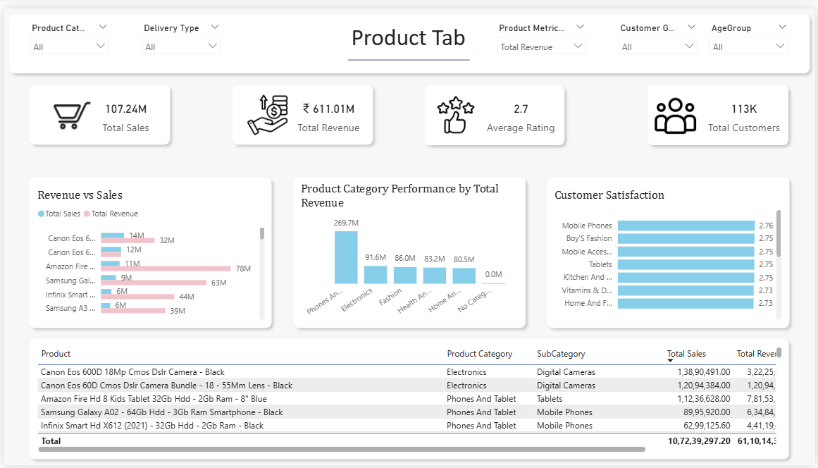
Power BI Dashboard Structure
• Product Tab performance

Slide 16
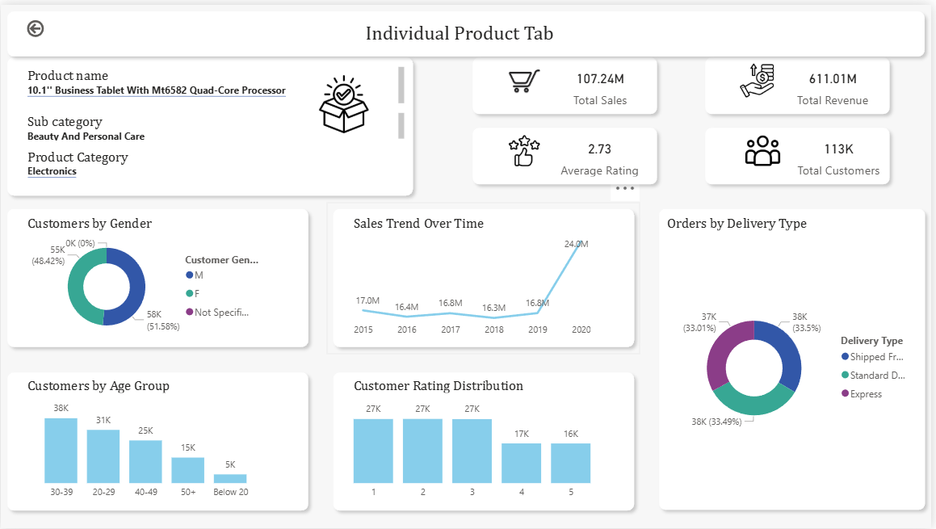
Power BI Dashboard Structure
• Individual Product Tab performance

Slide 17
Recommendation
Focus more on high-selling products by keeping enough stock and promoting them more.
Improve low-selling products by checking prices, customer reviews, and offering discounts if needed.
Reduce delivery time, especially for products shipped from abroad, to improve customer satisfaction.
Improve product images and descriptions to reduce returns and increase customer trust.
Run special offers and promotions during months with low sales.
Introduce a loyalty program to reward regular customers and encourage repeat purchases.
Regularly track sales and customer feedback to make better business decisions.

